Slide 1
Intonation in Australian languages
Janet Fletcher
School of Languages and Linguistics
University of Melbourne

Slide 2
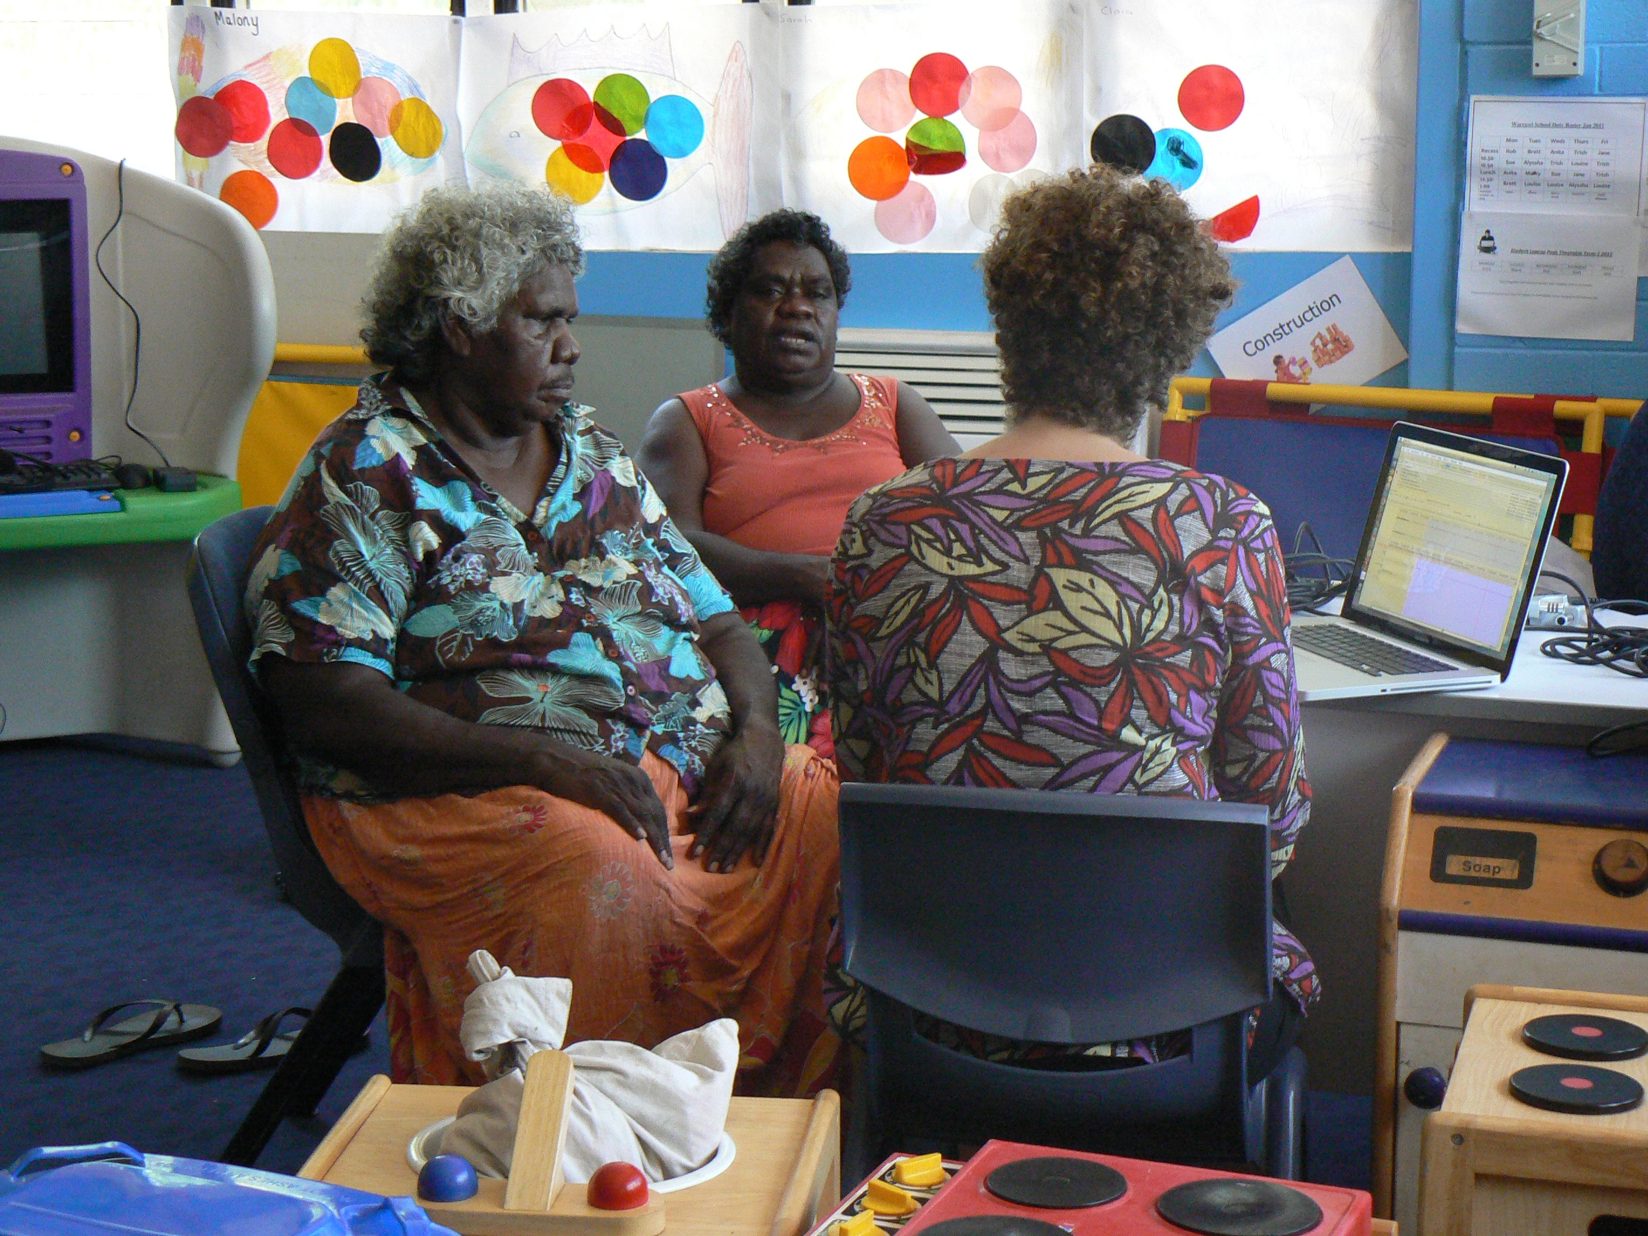
Overview
Intonational characteristics of a group of Australian indigenous languages (mainly Northern Australian languages)
Nita, Nancy, and Ruth,
Goulburn Island, NT

Slide 3
Why study intonation in Australian languages?
Many phonetic and phonological models of intonation are based on handful of well-studied languages – English, German, Japanese etc.
Need more work on less-well described languages to refine existing prosodic typologies
Until relatively recently, poorly understood and under-researched area of phonetics and phonology in the Australian context compared to “segmental” phonetics and phonology, word stress
Notes:
Need to outline the universalist view

Slide 4

And because of intonational phenomena like this…
Dalabon, Eastern Arnhem Land
Bininj Gun-wok (Kundedjnjenghmi variety),
Eastern Arnhem Land
Mawng, Goulburn Island

Slide 5
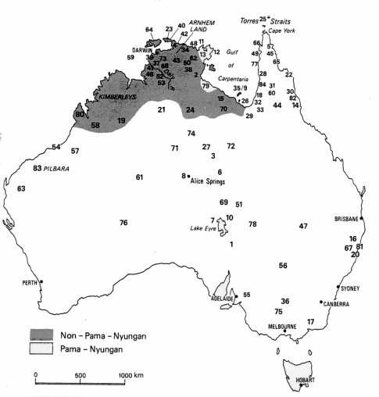
Bininj Gun-Wok (Non Pama-Nyungan, Gunwinyguan)
> 2000 speakers (dialect chain)
Dalabon
Non Pama-Nyungan
Gunwinyguan)
Pitjantjatjara (Pama-nyungan fam.)
Western Desert language
Severely endangered < 10 speakers
Around 3000 speakers
Adapted from: Stoakes et al. (2007); Evans, N. (1995)
Notes:
BGW is a non-Pama-Nyungan language
… which is spoken in this region of Western Arnhem Land.
Two major genetic groupings Pama-nyungan, Non-pama-nyungan
It is a dialect chain that includes Kune, Gun-djeihmi, Gundedjnjeihmi, Mayali and … Kunwinjku (the dialect to which the majority of speakers in the study belong). The majority of the data comes from Mamardawerre outstation.

Slide 6
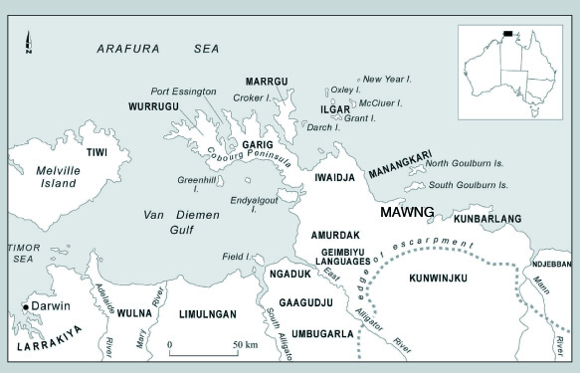
Mawng
Location:
Goulburn Island,
Northern Territory Australia
300 speakers
Iwaidjan family
non-Pama-Nyungan,
Typological profile:
Mildly polysynthetic
vs BGW & Dalabon which are highly polysynthetic -
All languages have relatively free word order compared to English, for example.

Slide 7
A major goal of intonational research
It is a major goal of intonational research on any language to sort out what tunes occur in a language and “to be able to make explicit predictions of how a given tune will be realized when it is applied to different texts”. (Ladd 2008; 201)

Slide 8
A classic view: What does intonation contribute to spoken communication?
Sentence Modality
Phrasing, discourse segmentation
Grammar of Focus marking; pragmatics
Speaker attitude, emotion, etc. (paralinguistic functions)

Slide 9
What do we know about intonation in Australian Languages?
Most traditional descriptive grammars of languages include statements about the segmental phonology of the language, phonotactic variation, word stress
Increased interest in the relevance of intonation:
  Information and discourse structure: topic, focus
  Grammatical organization, clause relations – languages are mostly non-configurational (i.e. word order gives no clues to syntax)
  Morphological complexity, stress; grammatical word – prosodic word mismatch
  Multilingualism

Slide 10
Why is Intonation hard?
F0 is hard to interpret or even analyse (particularly if you are dealing with an elderly group of speakers, and languages that none of us have as L1); speaker-specific variation
Other phonetic parameters; voice quality, duration, intensity..
Gradient rather than discrete
Difficult to sort out what is paralinguistic from linguistic - slippery form/function relationship “a slippery beast” (Gussenhoven 2004)
Symbolic representation not like IPA transcription of phonemes/ lexical tones

Slide 11
Universalist vs Linguistic Typological approaches (after Fitzpatrick 2000)
Completion, finality, declaratives: low/falling pitch
Incompleteness, non-finality, questions: high/rising pitch
New/salient information: local pitch peaks on some kind of constituent, often a word
Pitch declination across intonational phrases & pitch range or register reset at the beginning of intonational phrases; topic shift
Separate phonological component from phonetic implementation
Autosegmental-Metrical approach (Bruce 1977, Pierrehumbert 1980, Gussenhoven 2004; Beckman et al. 2005; Ladd 2008)
F0 contour is analysed as series of High and Low Tone targets that align with the text in particular ways

Slide 12
Questions we can ask using this approach (After Beckman 2006)
Tone inventory: What are the tones that make up the “tune” of an utterance, and where do they come from?
Do they come from the lexicon?
Intonational morphemes that are post-lexical, i.e. Syntax, Pragmatics, Discourse
Tone alignment: How is the “tone” anchored to the “text”?
word or phrase edge, i.e demarcative? e.g French, Korean
rhythmic prominence or “stress” i.e. prominence lending (e.g. German)?
Rhythmically-undifferentiated syllable i.e. Japanese?
Boundary tones, Phrase tones?
Pitch accents
Phonetic realization of the tones
Notes:
Based on Beckman 2006

Slide 13
What do we know so far about Australian languages?
Australian languages have definable and recognizable “falling” and “rising” tunes that delimit chunks of speech i.e. intonational phrases
Prominence-lending post-lexical pitch-accents that also combine with boundary tones to delimit the edges of these chunks.
No lexical tone; almost all have been analysed as having lexical stress, but phonetic analyses of “stress” realization – equivocal results – variable stress placement
King 1998; Fletcher & Evans 2000, Fletcher,Evans & Round 2002; Birch 2002, Bishop 2003; Bishop and Fletcher 2005, Round 2010; Ross 2011, Fletcher in press; also Simard 2010 for Jaminjung

Slide 14
4 important parameters
Accentual prominence
Tune - source of F0 variation
Phrasing – “chunking”
Pitch range – “graph paper” on which tones are realized
Notes:
Sort out relative contribution to “core functions”

Slide 15
What are we trying to find out?
Challenge 1: What are the characteristic tones and “tunes” of Australian languages?
Challenge 2: How does the tune align to the “text”?
  e.g. do tones line up with “rhythmically” prominent syllables in the word as well as demarcating the edges of phrases?
Challenge 3: What are these tunes used for?
Challenge 4: How do we model variation among languages?

Slide 16
Typical and (atypical) tunes‘
Each intonational phrase provides an opportunity for a new choice of tune... (Pierrehumbert and Hirschberg1990: 272).

Slide 17
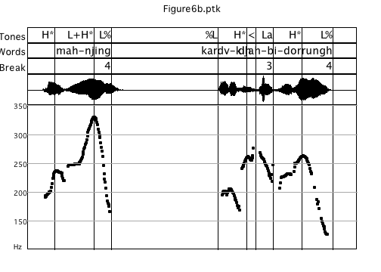
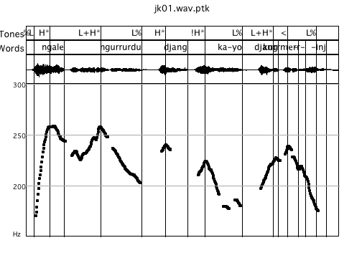
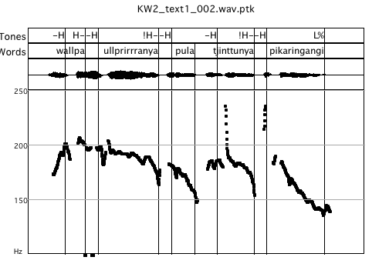
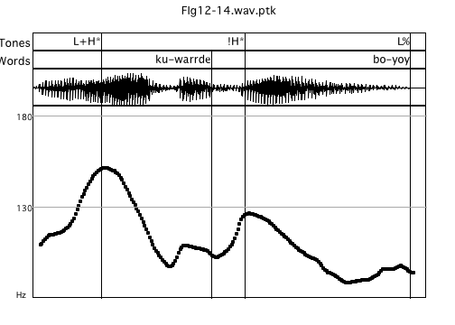
Falling tunes
Kundjedjedmi (BGW)
Kunwinjku (BGW)
Ngale ngurrurdu djang ka-yo djang-kurrme-rr-inj
“That emu of ours is a dreaming, she put herself in the landscape as a dreaming”
Ku-warrde bo-yoy “Water lay in the cave”
mah njing? kardû-kih djah-bi-dorrûngh
“What about you? Maybe you have got someone with you?"
Walpa ulpariranya pula tjintunya pikaringangi.
Wind south they two sun got angry.
Dalabon
Pitjantjatjara (read speech)
Notes:
Peaky vs flat

Slide 18
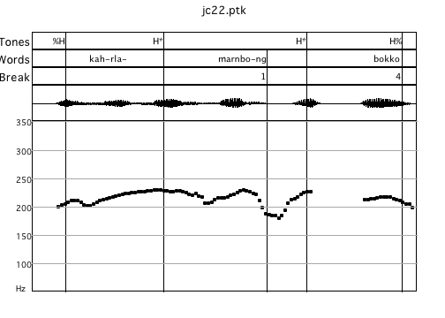
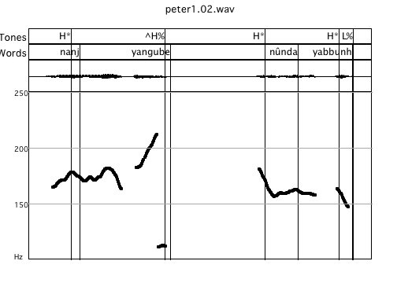
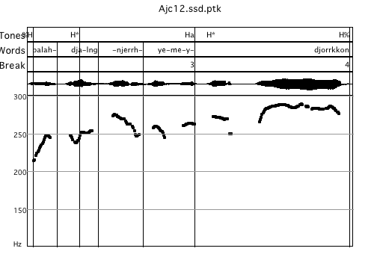
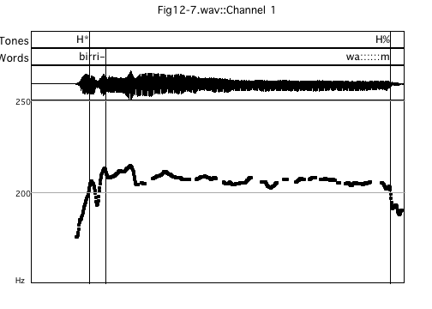
Rising & high level (non-falling) tunes
Rise
Level plateau-like
“(we make a windbreak), over there”
“(he made a spear), he made a hook spear”
Dalabon
Dalabon
“Stylized” high sustained contour
“They went along……”
“They took all the rock possums.”
Kuninjku
Also, Kayardild (Round 2010), Iwaidja (Birch 2002)…
Notes:
Also found in many other languages – Kayardild, iwaidja.. Narrative discourse – contintinuation – time….. Duration of activities etc. – we just stayed there for a long time

Slide 19
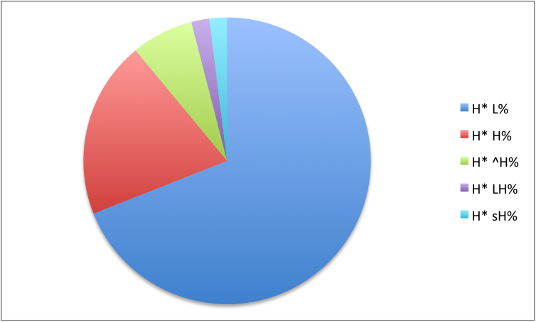
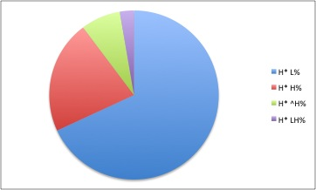
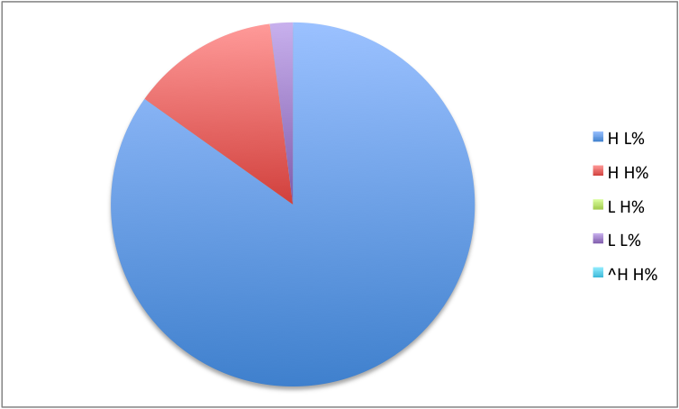
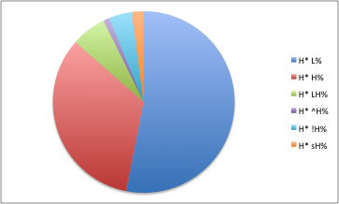
Tune distribution
Dalabon Narratives (Fletcher 2007, in press)
Dalabon Narratives (Ross 2011)
Rising
Rising
High level
High level
Falling
Falling
Bininj Gun-wok Narratives
(Fletcher & Evans 2002)
Pitjantjatjara (read speech)
(Tabain and Fletcher 2012)
Rising
High level
Falling
High level
Falling
See also Bishop (2003)
Notes:
Perhaps combine the Dalabon – also include %?

Slide 20
Tone Inventory - Dalabon
Intonational phrase
Pitch accents | Left-edge boundary tones | Right-edge boundary tones | Right edge minor phrase tones | Pitch Range
H* | (%L) | L% | (Lp) | HiF0
!H* ^H* | (%H) | H% | (Hp) | Final_Lo
L+H* |  | LH%
 |  | ^H%
 |  | H:: (Stylized rise)
90%
Local pitch range variation
e.g. English Pitch accents H* L* L+H* L*+H H+!H* H*+L,H+L*…
Dutch Pitch accents H*L L*H H* L* …
Notes:
Table woulld be better her.

Slide 21
Prosodic Hierarchy (after Selkirk 1979; Nespor and Vogel 1984)
Intonational Phrase (IP)
  |
  Phonological Phrase / Accentual Phrase
  |
  Prosodic Word (PW) |
    Foot
    |
    Syllable
Boundary Tones (preboundary lengthening, pause
glottalization)
Pitch accents

Slide 22
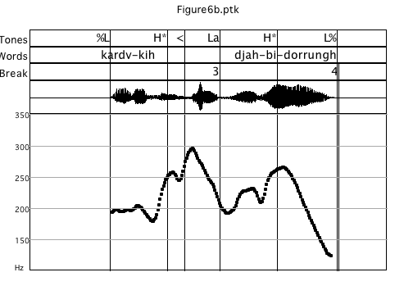
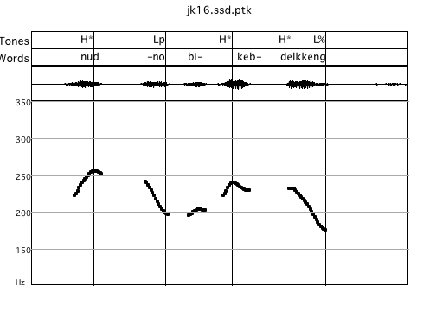
Stress-accent?
What do the Pitch Accents align to?
Pitch accents - first or second syllable of the word, often on the stem morpheme, also some prefixes, “stressed” syllable…
Antepenultimate, penultimate or final syllable of a phrase-final word
Variation in the Northern Languages, variable accent placement (often due to syllable deletion), delayed peaks, but usually first or last foot of word
Fletcher & Evans 2002, Bishop 2003, Fletcher in press
H*
H*
H*
Lp
L%
BGW - Kundedjnjenghmi
H*
H*
%L
Lp
L%
Dalabon – no accent on prefix
Notes:
Variation in the Northern Languages e.g. there can be an unaccented stretch of two syllables before the first H pitch accent

Slide 23
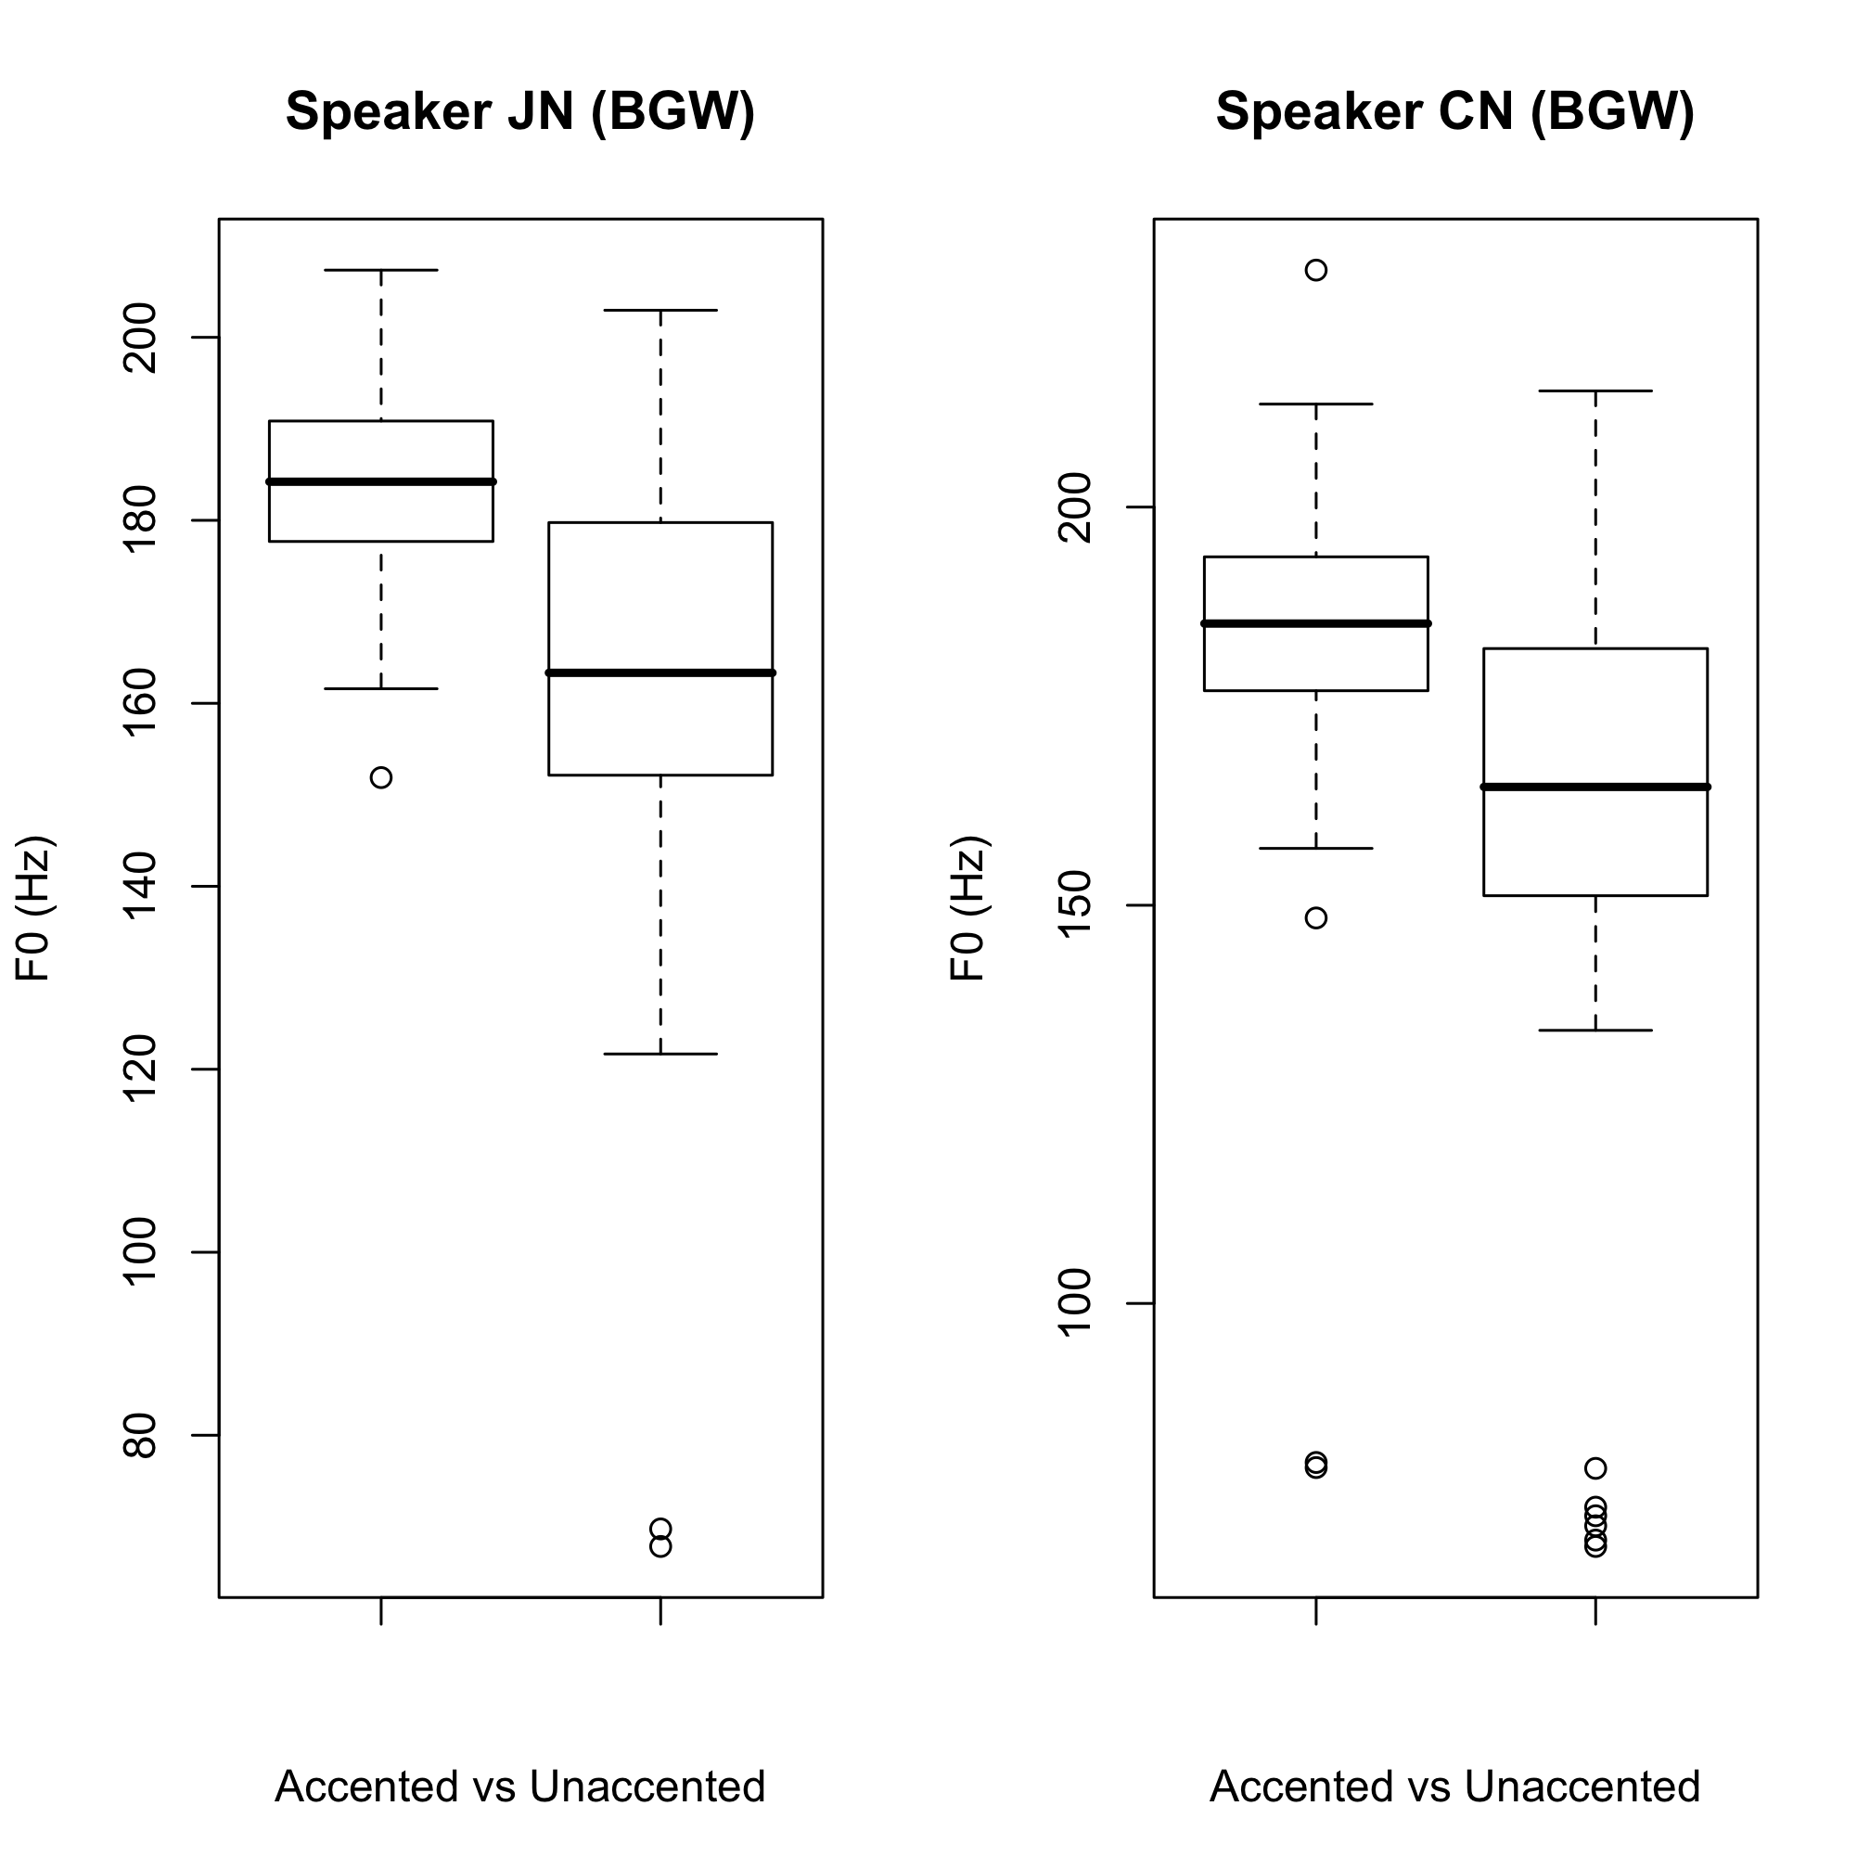
Accentual prominence in Kunwinjku
6 speakers
Minimal accentual lengthening in vowels
Accented vowels less variable in quality
Longer sonorants – post-tonic vowel
H*
H*
**
**
Fletcher et al. 2007, 2010

Slide 24
Boundary Tones and pitch range modification
Boundary tones mark the right edge - additional cue of final lengthening, not as pronounced as in European languages – with the exception of the stylized rises (King 1998, Fletcher and Evans 2002, Bishop 2003, Pentland 2004, Round 2010, Simard 2010)
Kundjedjedmi (BGW)
Downstep
Final Lowering
Pitch range reset
H*
L+H*
H*
L+H*
L%
!H*
L%
L%
“That emu of ours is a dreaming, she put herself in the landscape as a dreaming”

Slide 25
Tune and sentence modality

Slide 26
Falling tunes
Kundjedjedmi (BGW)
Kunwinjku (BGW)
Ngale ngurrurdu djang ka-yo djang-kurrme-rr-inj
“That emu of ours is a dreaming, she put herself in the landscape as a dreaming”
Ku-warrde bo-yoy “Water lay in the cave”
Pitjantjatjara (read speech)
Walpa ulpariranya pula tjintunya pikaringangi.
Wind south they two sun got angry.
Notes:
Peaky vs flat

Slide 27
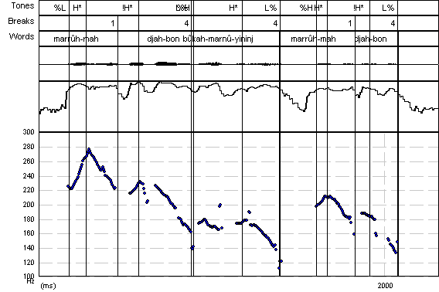

Dalabon WH-questions
Dalabon – interrogative intonation (WH- question)
Accent scaled higher
^H*
Downstep, pitch range compression
!H*
H*
!H*
%L
H*
H*
Lp
L%
L%
“Where are you going”
[repeated – afterhthought]
Notes:
What these languages might lack in terms of

Slide 28
Interrogative intonation in Mawng
Analysis of the QUIS - Question and information structure corpus - Mawng
Question word is often but not always first in the utterance and often is the location of the strongest /highest pitch peak, pitch downdrift or downstep through rest of the phrase
Similar pattern is realised without question word

Slide 29
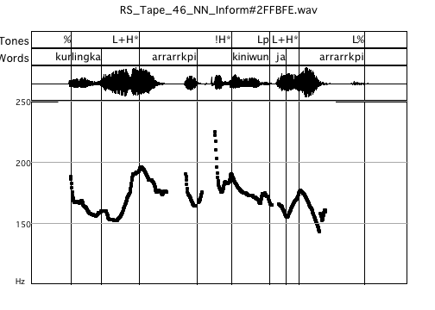
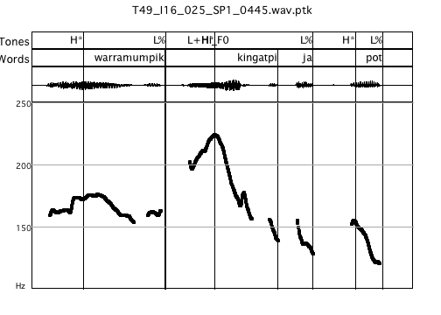
Polar questions & Interrogative markers - Mawng
No Question word
With a Question word
L+H*
L+H*
Question word
"Is a woman carrying the pot?"
“Is a man hitting a man?”
Notes:
Need pitch range comparison here.

Slide 30
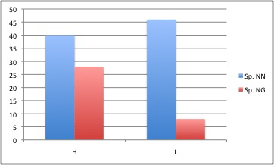
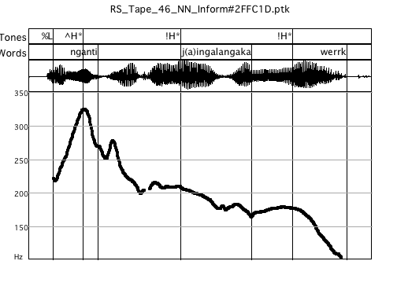
“Wh” -Question words - Mawng
+HiF0
-HiF0
L+H*
N. Q words
Question word
Questions – expanded pitch range
“Who is the one that she sent first?”
Similar pattern noted for imperatives…
Notes:
Need pitch range comparison here.

Slide 31
“Tune” & Sentence modality
Falling tunes – declaratives, but also questions, imperatives….
Non-falling tunes, continuitive, listing, non-finality…
No high rising question tunes in our narrative corpora but not a lot of questions are asked!!
Is possible to turn a declarative into a question with a final rise? Yes (e.g. Ngalagkan, Mawng, Warlpiri), just not that common!
Upwards re-setting of pitch range topline, register, but not necessarily a H% final rising boundary tone
Notes:
See this pattern will occur again.

Slide 32
Phrasing
Phrasing and Discourse segmentation

Slide 33
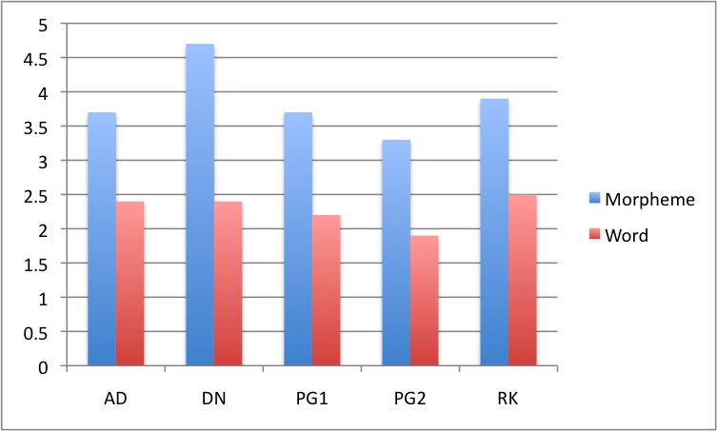
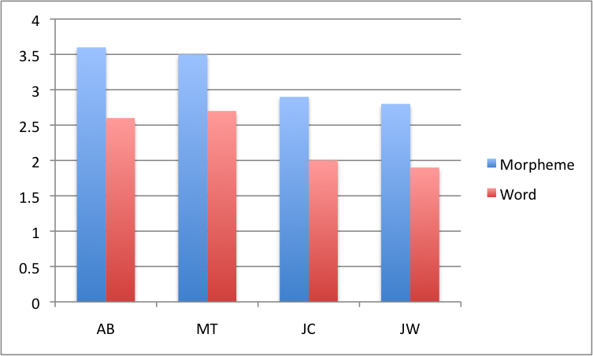
General patterns
Intonational Phrases often align with grammatical words (mildly – highly polysynthetic languages)
Bininj Gun-wok 1.9 grammatical words/IP (Bishop 2003; Bishop and Fletcher 2005)
Kayardild 2.3 words/IP
Dalabon 2.4 words /IP
Ross 2011
Notes:
Say something here about numbers. Also remind people about what defines a phrase

Slide 34
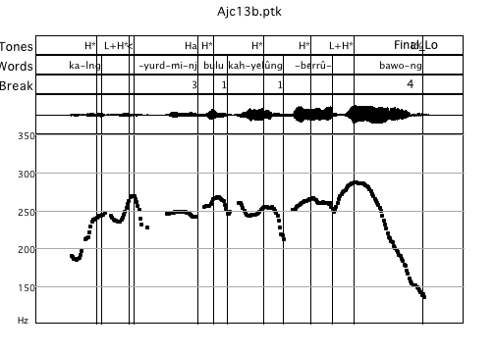
Dalabon – multi-verb Intonational Phrase
12% of IPs
“Semantic cohesion” of events
ka-lng-yurdmi-nj bulu ka-h-yelûng-berrû-bawo-ng ...
3SG-SEQ-run-PP them 3SG-R-SEQ-many-leave-PP
‘He ran away then and left them all.’
(Fletcher in press, Ross 2011)
Notes:
Also found in Bininj Gun-wok in a number of languages - large amounts of information can be packed into a single intonational phrase.

Slide 35
Intonational Phrasing - Dalabon
Accentual Phrase
Intonational Phrase
Marority of intonational phrases consist of one or two prosodic words (carrier of a pitch peak but no boundary tone)
(Fletcher in press)

Slide 36
“Paragraph” intonation – Global pitch range manipulation
Global pitch range reset
Tracking Pitch Topline (HiF0) across successive IPs in 4 BGW narratives
Topic shift
(Fletcher & Evans 2000)
Final lowering
Similar patterns across a range of other languages Kayardild, Iwaidja, Dalabon

Slide 37
Focus-marking
Typical intonational devices cross-linguistically
Prominence-lending pitch movement on focal constituent or absence thereof (de-accentuation)
Flexibility of nuclear accent placement (e.g. English, German)
Phrasing or de-phrasing, i.e. putting a word into its own separate intonational unit
Special pitch accent shape, e.g. L*+H in Bengali
Manipulation of local and global pitch range

Slide 38
Word order, Focus, and Intonation
Australian - ‘free word order’, “non-configurational” (Hale 1983)
Word order contributes to information structure categories such as given-new status, topic and focus.
Initial position - focus (or discourse prominence) in a large number of Australian languages (Baker and Mushin 2008)

Slide 39
Focus in Australian Languages
Intonation also plays an important role in marking focus in languages with more flexible word order, such as Hungarian (Zimmerman and Onea 2011) and Georgian (Skopoteas et al. 2009).
pitch range expansion on the focused word (e.g. Fletcher and Evans 2000, Bishop 2003, Simard 2010)
rising pitch accent shape L+H* anchored to the focused word may also be used (e.g. Bininj Gun-wok; Bishop 2003, Bishop and Fletcher 2005)
Intonational phrasing – focused element is also often realized as its own IP separated by a pause from following material in the same “clause” (e.g. Bishop 2003, Simard 2010, Fletcher in press, Ross 2011).

Slide 40
Focus in Mawng
Experiment was conducted to elicit contrastive or “corrective” focus through a scripted interaction
Interaction between word order: local and phrasal pitch range, pitch accent location & realization, and intonational phrasing.

Slide 41
“Broad” focus
“Statement style” intonaton, limited affect, narrow pitch range “We call it puffer fish.”
Notes:
Note that labels not clear because imported back from EMU to Praat

Slide 42
First part of response
“Correction” context a. Major pitch movement on “call” - target word (object) is realized in reduced range
target word (object)
Unaccented

Slide 43
Typical Pattern - Corrective focus
“Correction” context b. Focus word fronted, also receives highest pitch peak, and/ or realized as a separate IP
Fronted (object) target word
Pitch range compression of following material
Good example of Word-initial accentual prominence

Slide 44
Neutral context - “broad focus”
Typical phrasal, declarative intonation
Nouns & VP “tokens” utterance final – attract a penultimate pitch accent.
Often realized as separate minor intonational phrase.
Clear differences between VP and Nouns
%
Same IP
Separate IP
Notes:
VP - as you would expect - longer

Slide 45
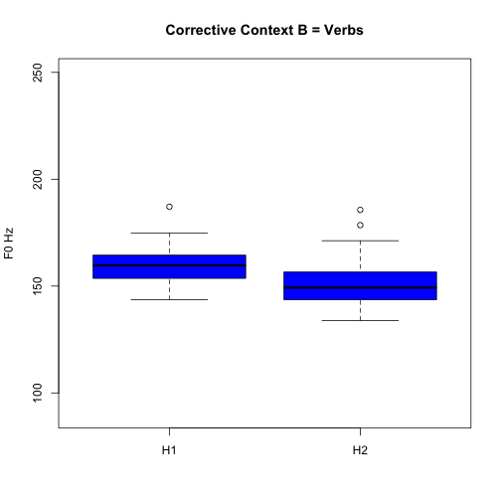
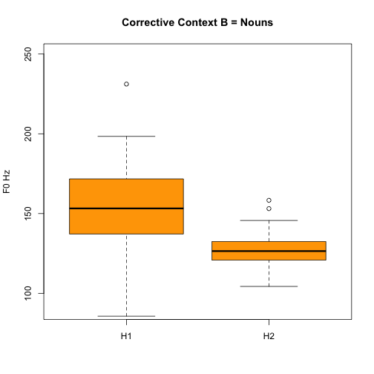
“We don’t CALL it stonefish.”
Suppressed pitch topline – HiF0
F0
Target word
**(p<0.001)
%
ns
Same IP
Separate IP

Slide 46
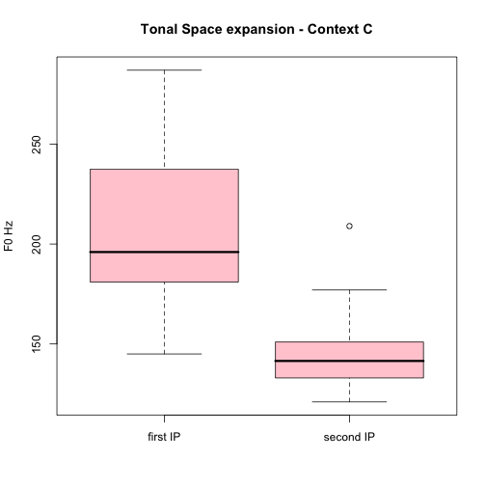
“We call it PUFFER FISH.”
Focal Noun
F0
***
%
Same IP
Separate IP
Pitch range suppression of following IP, also in verbs
Fronted verbs and nouns in their own IP, realised in expanded pitch range
“prosodic dislocation”

Slide 47
Implications
Similar strategies to those employed in other “free” word order languages
Syntactic fronting - intonational phrasing, possible variable pitch accent realization (LH* vs H*)
Consistent pitch range / register manipulation, not unlike the register manipulations that are observed in radically different languages e.g. tone languages
Similar to polar/”Wh” – questions, imperatives etc minus prosodic dislocation
Nouns are special – often missing in conversational discourse

Slide 48
The story so far….
Fewer “tones” i.e. fewer intonational pitch accent shapes compared to Germanic languages, e.g. German, Dutch, English but there is intonational variation!
Distinctive plateau and “stylized” high tunes in narrative discourse (also Round 2010, Kayardild, Simard 2010, Jaminjung)
Importance of phrasing, and pitch range manipulation
Traditional intonational functions: modality, phrasing and discourse segmentation, and focus marking

Slide 49
Speaker attitude – paralinguistic effects
Pitch register shifts, story telling, reported speech
Use of other features besides F0, particularly in story telling, narrative discourse
Voice quality modification
…but that’s another story

Slide 50
The challenges..
On-going challenge of teasing apart word-level and phrase-level stress
Variability - some Australian languages are probably more “phrasal”, some more “accentual”
Varying evidence that there are consistent cues to accentual prominence beyond pitch – implications for lexical prosody
AM framework can accommodate variation (e.g. Hualde 2006, Ladd 2008, Beckman and Venditti 2010)
Look beyond F0

Slide 51
The challenges..
Importance of analysing different genres, including interactive discourse as well as narratives, controlled elicited materials etc.
What about perception and processing?
To be continued…

Slide 52
Acknowledgements
Our language consultants
Nick Evans, Ruth Singer, Marija Tabain, Andy Butcher, Debbie Loakes, Hywel Stoakes, Simone Graetzer, Anna Parsons
Australian Research Council and University of Melbourne

Slide 53
References
Baker, Brett & Ilana Mushin (2008). Discourse and grammar in Australian languages. In Mushin, Ilana & Brett Baker (eds.) Discourse and grammar in Australian languages. Amsterdam: John Benjamins. 1-24.
Beckman, M. & Venditti, J. 2010. Tone and Intonation. In. W.Hardcastle et al. (eds.) Handbook of the Phonetic Sciences (2nd ed). Wiley-Blackwell
Beckman, M. et al. (2005). The original ToBI system and the evolution of the ToBI framework. In S-Jun (ed.) Prosodic Typology: The phonology of intonation and phrasing. Oxford:OUP
Birch, B. 2002. The IP as domain of syllabification. Proceedings of the 1st International Conference on Speech Prosody, B. Bel and I. Marlien, Eds. Aix-en-Provence: Laboratoire Parole at Langage, 2002
Bishop, J. 2003. Aspects of prosody and intonation in Bininj Gun-wok. PhD thesis (available online through the University of Melbourne e-prints repository)
Bishop, J. and Fletcher 2005. Intonation in six dialects of Bininj Gun-wok. In Jun S-A. Prosodic Typology, Oxford:OUP
Bruce, G. (1977). Swedish word accents in sentence perspective. Lund: CWK Gleerup.
Fitzpatrick, J. (2000) On intonational typology. In Peter Siemund (ed.) Methodological Issues in Language Typology. Sprachtypologie und Universalienforschung 53: 88-96.

Slide 54
References
Fletcher J. (in press). Intonation in Dalabon, in. S-A. Jun (ed.) Prosodic Typology II, Oxford:OUP
Fletcher J. 2005. Exploring the Phonetics of Spoken Narratives in Australian Indigenous Languages. In Hardcastle WJ & Mackenzie Beck J (eds), A Figure of Speech: A Festschrift for John Laver. New Jersey, United States: Lawrence Erlbaum Associates, pp. 201-226.
Fletcher, J. and Evans N. 2000. Intonational downtrends in Mayali. AJL 20, 23-38.
Fletcher, J. and Evans N. 2002. An acoustic phonetic analysis of intonational prominence in two Australian languages, JIPA 32, 123–40.
Fletcher, J., Stoakes, H., Loakes, D., Butcher A. 2007, Spectral and durational properties of vowels in Kunwinjku. Proceedings of the 16th International Congress of Phonetic Sciences. 937-940. SAARBRUCKEN, Germany: UNIVERSITY OF SAARLAND.
Fletcher J, Butcher A, Loakes DEL & Stoakes HMS. (2010). Aspects of nasal realization and the place of articulation imperative in Bininj Gun-Wok. In Tabain M. et al. (eds), Proceedings SST2010, 78-81. Melbourne, Australia: Australasian Speech Science and Technology Australia (ASSTA).
Fletcher, J., N. Evans, and E. Round, (2002).Left-Edge tonal events inKayardild (Australian): a typological perspective. Proceedings of the 1st International Conference on Speech Prosody, B. Bel and I. Marlien, Eds. Aix-en-Provence: Laboratoire Parole at Langage, 2002, pp. 295-298.

Slide 55
References
Fletcher, J., Singer, R., Loakes, D. (2012). Intonation and focus-marking strategies in Mawng. Tone and Intonation in Europe 5. Oxford, September 2012.
Hale, Kenneth (1983). Warlpiri and the grammar of non-configurational languages. Natural language and linguistic theory 1: 5-47.
Hualde, J. (2006). Remarks on word-prosodic typology. Proceedings of the Berkeley Linguistics Society, 32
King, H. (1998). The declarative intonation of Dyirbal. Lincom Europa
Gussenhoven, C. (2004). The phonology of tone and Intonation. Cambridge:CUP
Ladd, D.R. (2008). Intonational phonology. Cambridge:CUP
Pierrehumbert, J.(1980): The Phonology and Phonetics of English Intonation. Ph.D. dissertation, MIT.
Pierrehumbert, J. & Hirschberg, J.(1990): The meaning of intonational contours in the interpretation of discourse, in: Cohen, P. R. el al.(eds.), Intentions and Communication, Cambridge: MIT Press. 271–311.
Ross, B. (2011). Prosody and grammar in Dalabon and Kayardild. PhD thesis, University of Melbourne (available through UniMelb e-prints)

Slide 56
References
Ross, B., Fletcher,J. & Nordlinger (in prep.). Intonation and grammatical structure in Dalabon.
Round, E. (2010). Tone height binarity and register in intonation:the case from Kayardild (Australian). Proceedings of Speech Prosody 2010
Simard, Candide (2010). The Prosodic Contours of Jaminjung, a Language of Northern Australia. Manchester: University of Manchester PhD.
Skopeteas, Stavros, Caroline Fery & Rusudan Asatiani (2009 ). Word order and intonation in Georgian. Lingua: 102-127.
Zimmerman, Malte & Edgar Onea (2011). Focus marking and focus interpretation. Lingua 121: 1651-1670.

